Slide 1
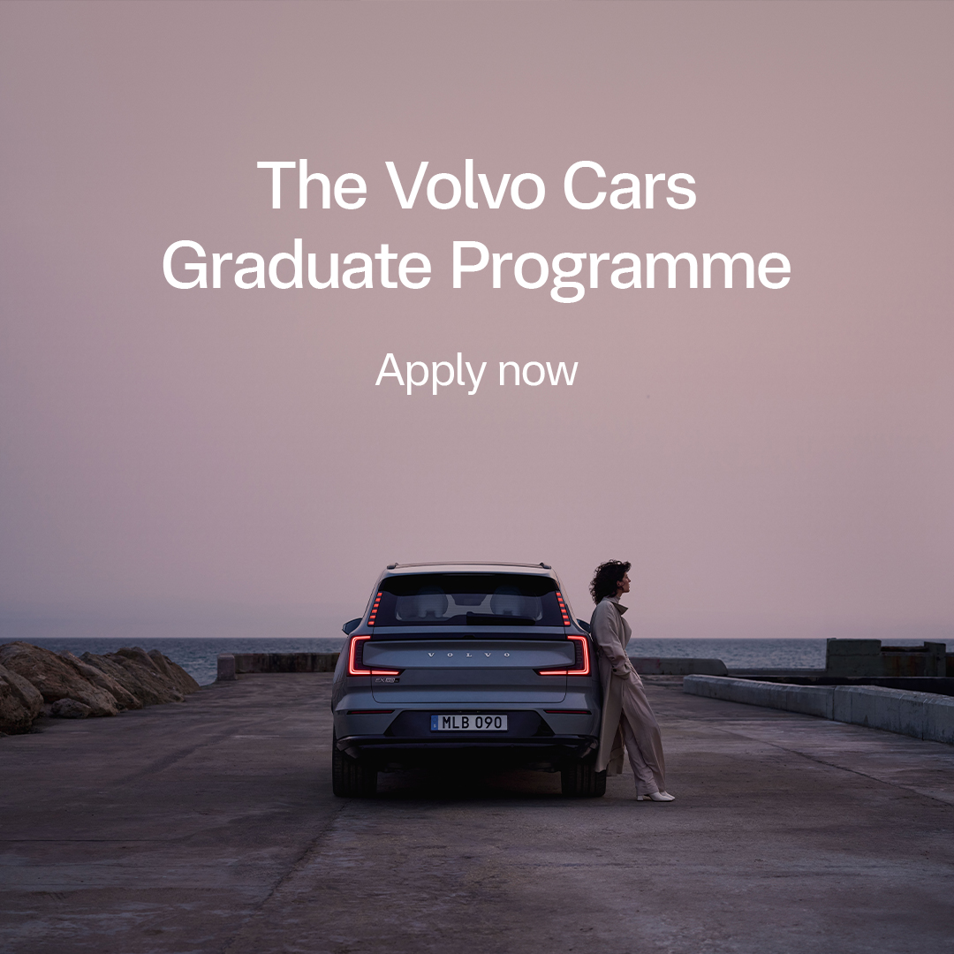
Join Volvo Cars Graduate Programme 2026
Kick-start your career with hands-on learning, global exposure and senior mentorship. During 18 months, you’ll rotate through Engineering, Manufacturing and Commercial functions, working hands-on with impactful projects and global teams. You’ll discover different roles, stretch your skills and explore new ways to grow, learn and challenge yourself.
You’ll be part of a collaborative, inclusive community of graduates. With cross-functional rotations, targeted learning modules, and mentorship from executive leaders, you’ll develop the leadership skills and confidence to drive innovation across Volvo Cars.
Who are you?
To be considered for the program, you must have a Master's degree within engineering completed between December 2024 and September 2026. Do you have drive, will and curiosity! Go all in. Apply today and shape the next 100 years.
Career Graduates | Volvo Cars - INTL

Slide 2


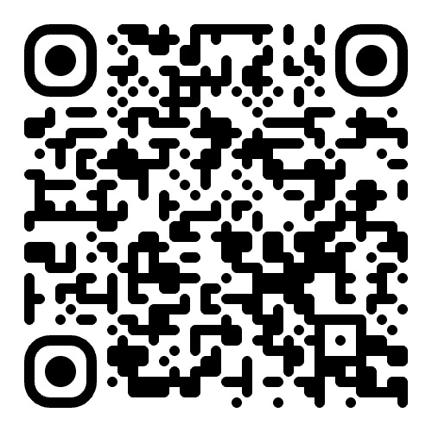
Go all in. Shape the next 100 years.
Fast track your career. Build a global network and gain experience through cross functional rotations in the
Volvo Cars Graduate Programme.
Shape what’s next. Apply today.

